Slide 1

Abara One More
Feb.17.2023 Ash-Hun

Slide 2
Index
⬛ Importance of Testing
⬛ Logic of Testing
⬛ Category of Testing
⬛ TDD (Test Driven Development)
⬛ Why TDD?
⬛ TDD Development Cycle
⬛ Advantage of TDD
⬛ Example of TDD

Slide 3
Importance of Testing
개발자들이 말하는 Testing?
제품 or 서비스의 품질을 확인, SW의 버그를 찾는 것
즉, 제품이 원하는 대로 동작하는지 확인하는것!

Slide 4
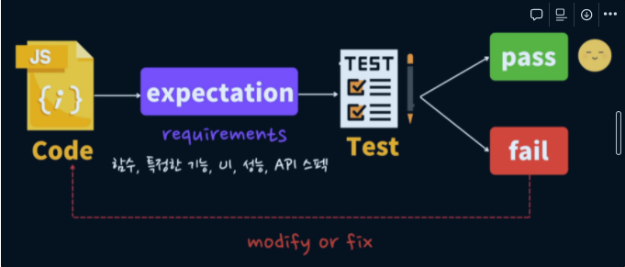
Logic of Testing

Slide 5
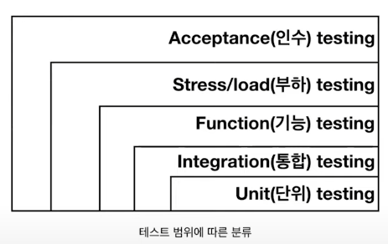
Category of Testing

Slide 6
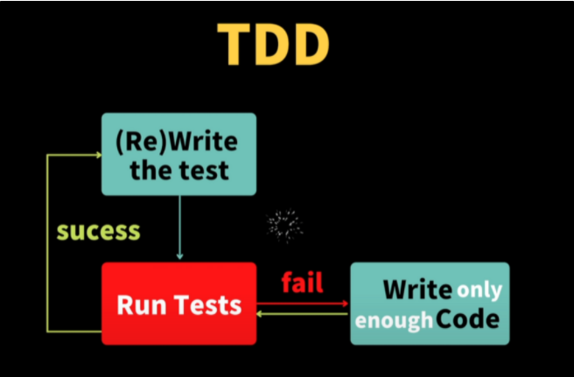
TDD (Test Driven Development)

Slide 7
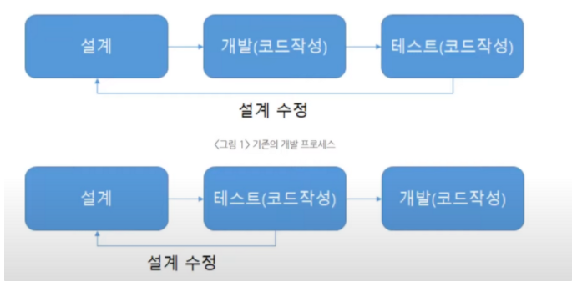
Why TDD?

Slide 8
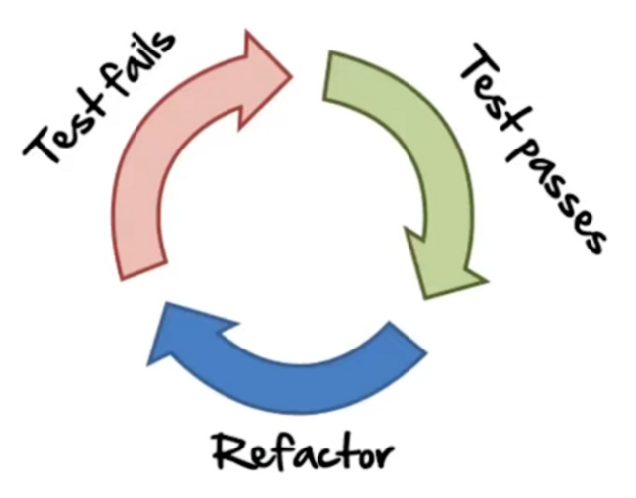
TDD Development Cycle

Slide 9
Advantage of TDD
자연스럽게 Test Coverage가 높아진다.
Over Engineering을 방지한다.
설계에 대한 Feedback이 빠르다.

Slide 10
Advantage of TDD
F – Fast(빠르게)
I – Independent(독립적으로)
R – Repeatable(반복가능하게)
S – Self Validating(자가 검증하는)
T – Timely(적시에)

Slide 11

Example of TDD

Slide 12
Any Qusetion?

Slide 13
Ref
[10분 테코톡] : https://www.youtube.com/watch?v=3LMmPXoGI9Q&t=374s
[Geeks for Geeks] : https://www.geeksforgeeks.org/performance-testing-software-testing/
[파이썬 TDD예제] : https://brain-nim.tistory.com/66

Slide 14
Thank you
Feb.17.2023 Ash-Hun

